Slide 1
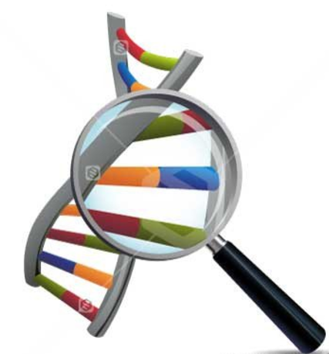
DNA Provides Evidence for Evolution
Comparative Genomics
Endogenous Retroviruses
Mitochondrial DNA

Slide 2
Date: | Human Biology Year 12 ATAR
Do Now Get out equipment Lesson Agenda 1: Do Now 2: DNA evidence for evolution – ERV and mtDNA 3: Lesson summary and wind-up Suggested Study Read through today’s notes and textbook section Do review worksheet and mark using the marking key on Connect NEXT LESSON DNA evidence for evolution – Protein sequences, Bioinformatics | Learning Aims Review DNA, protein production and variation List types of DNA that can be compared to assess relatedness between organisms Define the term “endogenous retrovirus” and describe how these can be used to map relatedness between organisms Define mtDNA, describe how it is inherited and explain how it can be used to determine relatedness between organisms.
 | Key Vocabulary DNA Endogenous Retrovirus Mitochondria Haplogroup

Slide 3
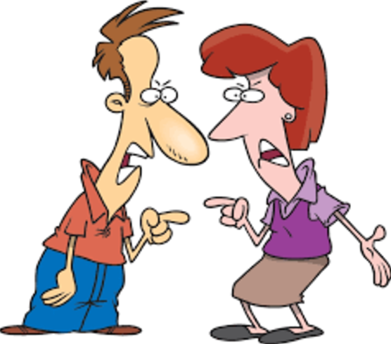
Overview
Idea of evolution and evidence for it accepted by vast majority of scientists
Has been controversial for reasons unrelated to the scientific evidence
Important to look at evidence to support scientific theory
Recent advances in technology provide further evidence to support the theory of evolution

Slide 4
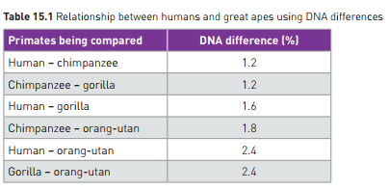
Evidence for Evolution – Comparing DNA (comparative genomics)
DNA
Uses sequences of 4 nitrogenous bases
Codes for protein production
All living things use the same 4 bases, the same DNA code – indication of common origin
Sequence of bases varies
Mutation
Natural selection
Genetic Drift
As living things reproduce, code differs over generations among offspring, despite common ancestor, but some stays the same.
More distantly related: greater variation
Closely related: more shared
Learning Aim: Review DNA, protein production and variation.

Slide 5
Evidence for Evolution – Comparing DNA
Chromosomes also contain sequences of bases that don’t appear to code for anything:
Non-coding, or “junk DNA”
Also varies across generations due to random mutation.
Can also be compared for similarities and differences to assess relatedness.
Other examples of DNA that can be compared to assess relatedness
Endogenous retroviruses (ERV)
Mitochondrial DNA
Learning Aim: List types of DNA that can be compared to assess relatedness between organisms.

Slide 6
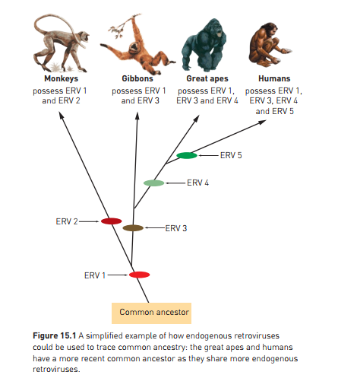
Comparing DNA - Endogenous Retroviruses
Retroviruses are viruses that incorporate their DNA code into the cells of the infected organism. Some don’t cause illness.
Endogenous retroviruses are viral sequences that have become part of the genome in the germline cells of the host organism.
They are therefore passed on to each new generation
Make up 8% of human genome
Other primates have some of the same sequences in the same locations, indicating that we, and they, are descended from a common ancestor who was originally infected with the virus.
Can map this (see diagram) to show relationships in terms of common ancestors, between modern species.
Note: In order to compare this, we need to sequence the genome using the techniques previously discussed:
PCR to amplify sample
Sequencing
Electrophoresis
Learning Aim: Describe how endogenous retroviruses can be used to map relatedness between organisms.

Slide 7
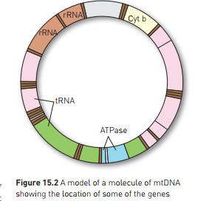
Comparing DNA- mtDNA
mtDNA = mitochondrial DNA. From mitochondria which has it’s own DNA separate to the nuclear DNA
Small circular molecules
mtDNA: 37 genes, all essential,
24 code for tRNA
Inherited from mother – in cytoplasm of ovum
Can therefore trace female ancestral line
mtDNA has slowly diverged via random mutation from common female ancestor “Mitochondrial Eve” (note the mutations do not cause impairment of function – they are point mutations that do not change the amino acids produced)
Can compare level of similarity between individuals to see how long ago their last common ancestor lived.
Also used to track migration routes of ancient humans
Learning Aim: Describe how mtDNA can be used to map relatedness between organisms.

Slide 8
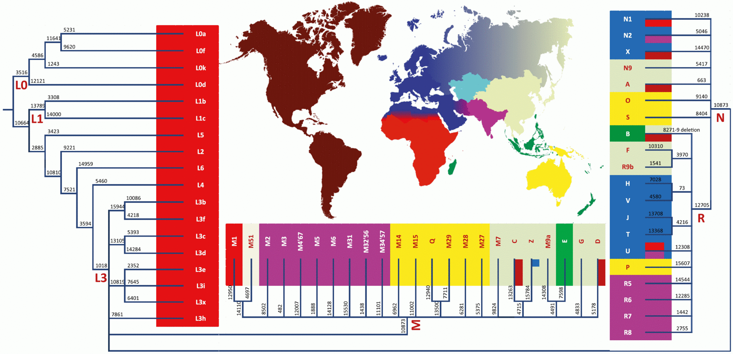

Slide 9
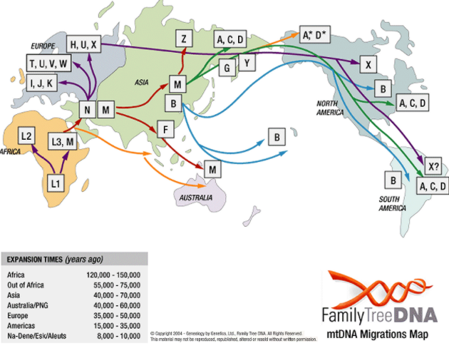

Slide 10
mtDNA: important tool in mapping relationships between species
Verifies other evidence
eg: examination shows that last common ancestor of modern humans and neanderthals lived around 600 000 years ago.
(This does not mean that the last neanderthal was then. Why?)
Learning Aim: Describe how mtDNA can be used to map relatedness between organisms.

